Slide 1
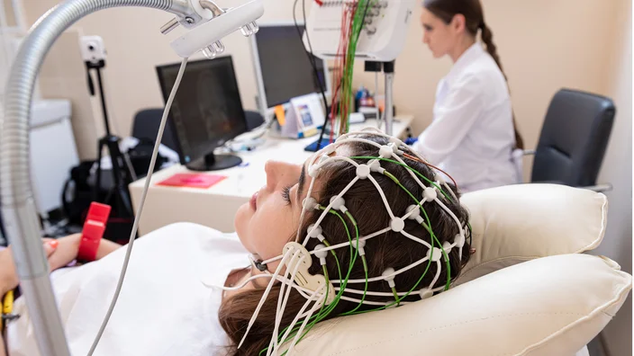
DETECTION OF PARKINSON AND ALZHEIMER'S DISEASE
(using EEG signals)
By:
N. Sai Geethika
N. Renu Sri

Slide 2
Table of Contents
Abstract
Novelty
Introduction with Symptoms
Methodology & Block Diagram
Literature Review
Limitations
Issues Identified
Input & Output
Objectives
Advancements & Future Scop
Why only EEG signals?
Conclusion
Challenges in analyzing EEG signals

Slide 3
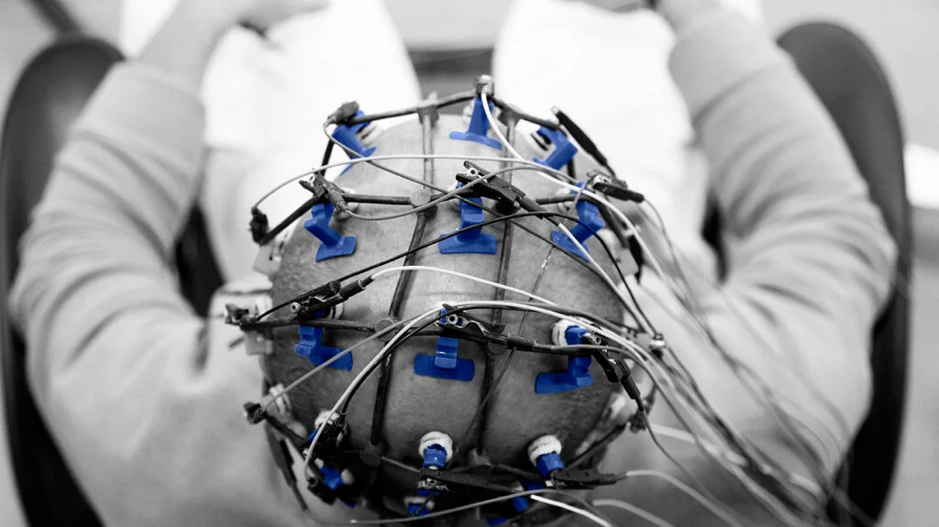
ABSTRACT
• The study aims to develop a responding interface using EEG signal data for Parkinson’s and Alzheimer's disease detection.
• The performance of the proposed machine learning approaches was evaluated using sensitivity, specificity, overall diagnosis accuracy.

Slide 4
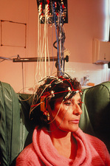
INTRODUCTION:
Parkinson's disease (PD) and Alzheimer's disease (AD) are neurodegenerative disorders that have a significant impact on the affected individuals and their families.
In recent years, there has been growing interest in utilizing EEG signals for the early detection and prediction of PD and AD.

Slide 5
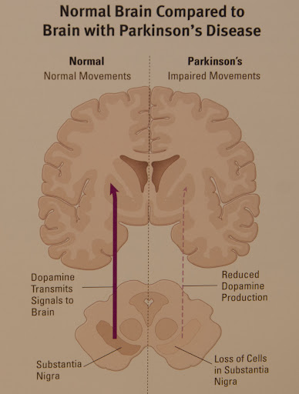
Symptoms of Parkinson’s disease:
Muscle stiffness
Slowness of movement
Depression
Impaired balance and coordination

Slide 6
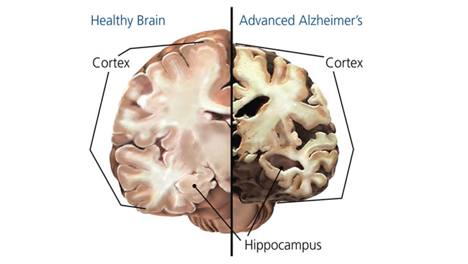
Symptoms of Alzheimer’s disease:
Memory loss
Loss of interest in activities
Mood swings
Anger or aggression

Slide 7
Literary Review:
(Parkinson’s disease)
Title | Year | Findings
Deep Learning Approach for PD Diagnosis | 2018 | Oh et al. (2018) proposed a deep learning approach for the diagnosis of PD from EEG signals. The study demonstrated the potential of deep learning models in accurately identifying PD based on EEG data.
Long Short-Term Memory-Based Deep Learning Models | 2023 | Ushiku (2023) investigated the use of long short-term memory-based deep learning models for screening PD using sequential diagnostic codes. The findings suggested that these models have promising applications in the early screening of PD.
Novel PD Diagnosis Index using Higher-Order Spectra Features | 2018 | Yuvaraj et al. (2018) introduced a novel Parkinson's Disease Diagnosis Index using higher-order spectra features extracted from EEG signals. The study highlighted the potential of advanced signal processing techniques for improving the accuracy of PD diagnosis.
Detection of Freezing of Gait in PD Patients | 2012 | Handojoseno et al. (2012) explored the detection of Freezing of Gait in PD patients using EEG signals based on Wavelet decomposition. The findings indicated the feasibility of using EEG signals to identify motor symptoms associated with PD.

Slide 8
Literary Review:
(Alzheimer’s disease)
Title | Year | Findings
CSF Aβ1-42 Combined with Neuroimaging Biomarkers | 2014 | Lista et al. (2014) investigated the combined use of cerebrospinal fluid (CSF) Aβ1-42 and neuroimaging biomarkers for the early detection, diagnosis, and prediction of AD. The study emphasized the potential of multimodal approaches for improving the accuracy of AD prediction.
Early Detection of AD from EEG Signals using Hjorth Parameters | 2021 | Safi and Safi (2021) proposed an approach for the early detection of AD from EEG signals using Hjorth parameters. The findings suggested that these parameters could serve as effective biomarkers for the early identification of AD.

Slide 9
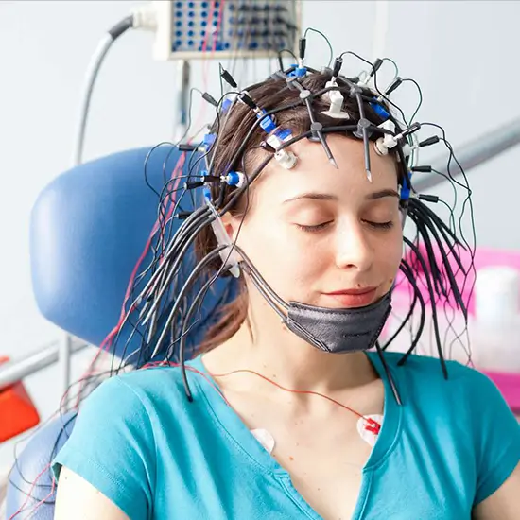
Issues Identified:
1.Feature Extraction and Selection:
Complex Features
High Dimensionality
2.Integration with Other Biomarkers:
Multimodal Approaches
3.Longitudinal Studies:
Time Series Analysis

Slide 10

OBJECTIVES:
Develop a machine learning model for the detection of Alzheimer and Parkinson using electroencephalography (EEG) signals.
Implement real-time monitoring systems for continuous state of disease detection and prediction.
Evaluate the performance of the proposed models on diverse EEG datasets to assess generalizability and reliability.

Slide 11
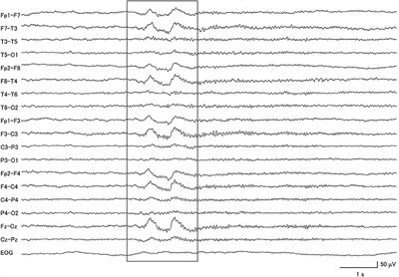
Why only EEG SIGNALS?
Non-invasive and safe
Response to Medication
Cost-effectiveness

Slide 12
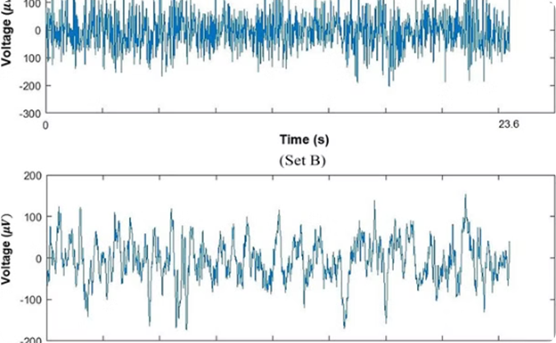
Challenges in analyzing EEG signals :
Signal Noise: Supposed by muscle movements, eye blinks, and environmental interference, obscures neural patterns.
Signal Variability: High variability across individuals and within the same individual over time.
Complexity of Signal Processing: Requires advanced techniques and deep understanding of neurophysiology, making it time-consuming and computationally intensive.

Slide 13
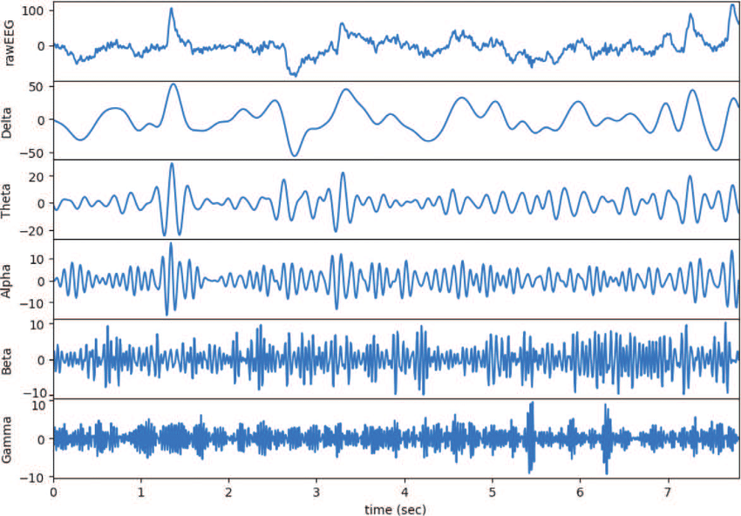
NOVELTY:
Enhanced Data Collection: BCIs provide continuous EEG data for machine learning models, capturing real-time brain activity.
Improved Feature Extraction: Advanced signal processing capabilities reduce noise and artifacts, capturing relevant disease state patterns.
Patient-Specific Adaptations: BCIs can be personalized for individual patients, providing tailored EEG data for effective disease detection and prediction.

Slide 14
Methodology &
Block Diagram:
Classification & Cross-Validation
Detection of the disease
Feature Extraction
5
Pre-processing
4
3
EEG signals
2
1

Slide 15
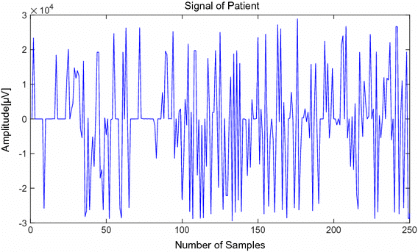
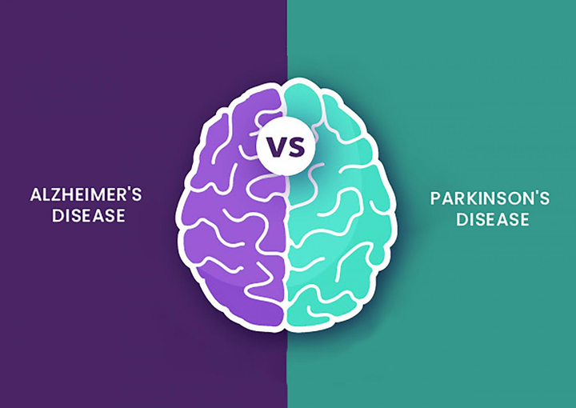

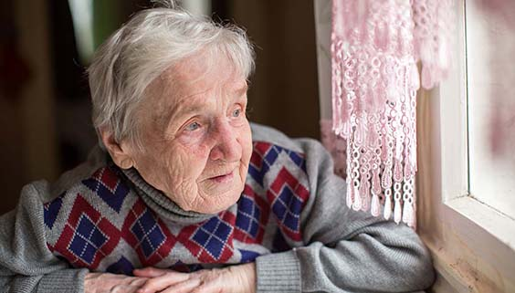
Idea OutLine:-
Patient
Collect Dataset of EEG Signals
from the patient
Detecting whether it’s parkinson’s or alzheimer’s
Result Displaying

Slide 16
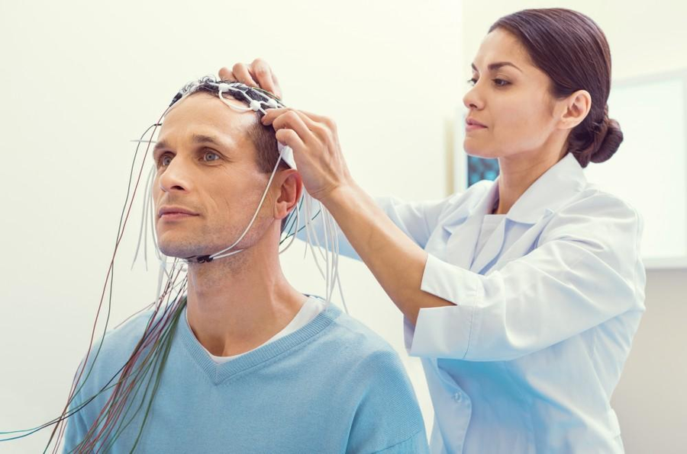
Limitations:
Spatial Resolution: EEG's detection may not accurately localize deep brain structures.
Signal noise and artifacts: EEG signals are susceptible to noise and artifacts, obscuring meaningful neural patterns.
Temporal dynamics: EEG captures real-time neural activity but may not capture subtle changes in brain function.

Slide 17
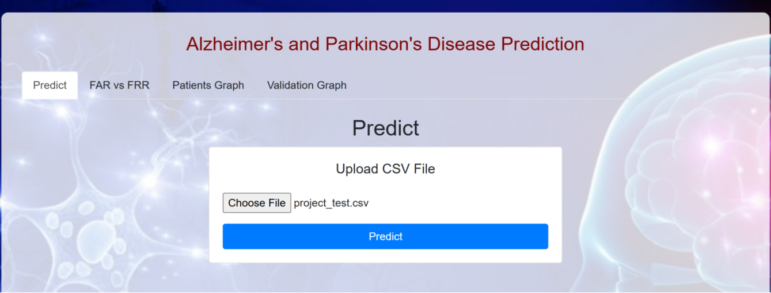
Input:
The “.csv “ file will be given as input to the interface

Slide 18
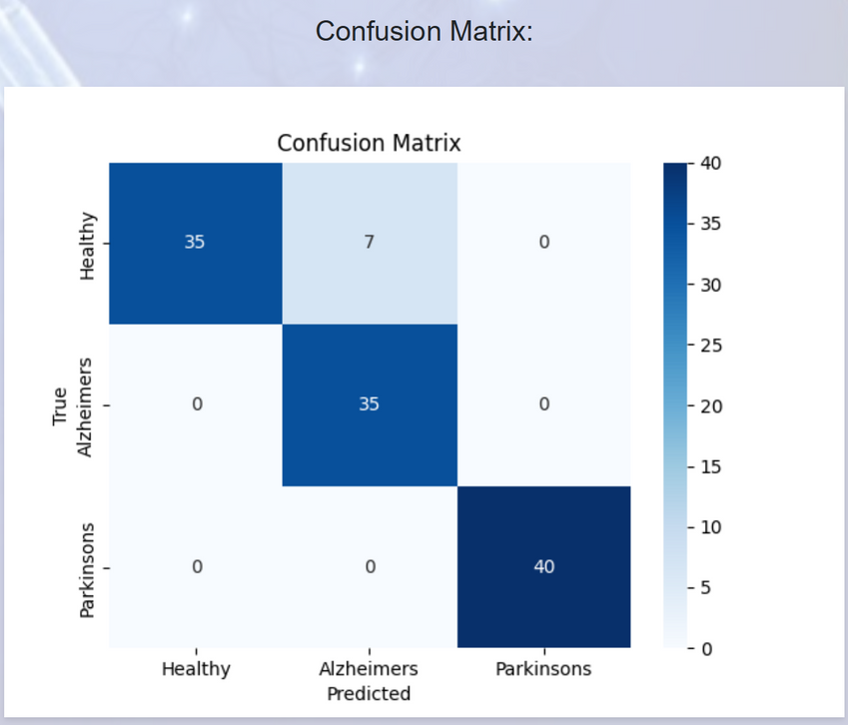
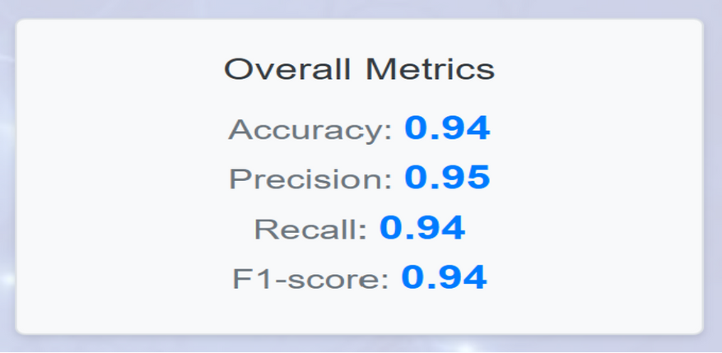
Output:
Here we can see the overall metrics and the confusion matrix of the given dataset. the accuracy we are getting here is the 0.94

Slide 19
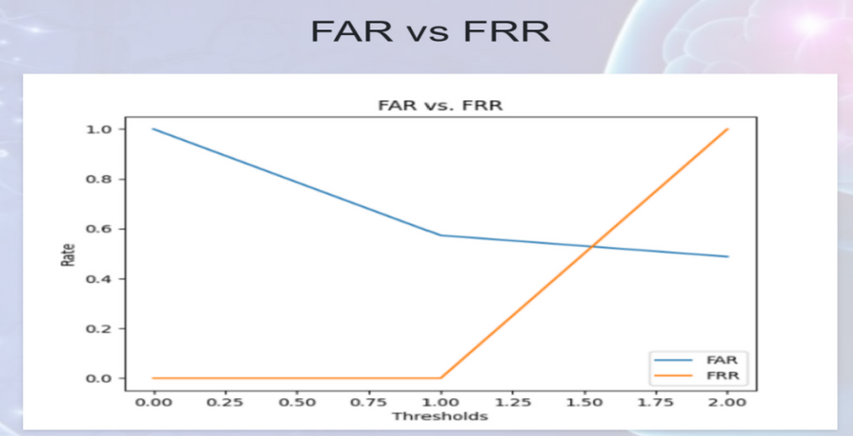
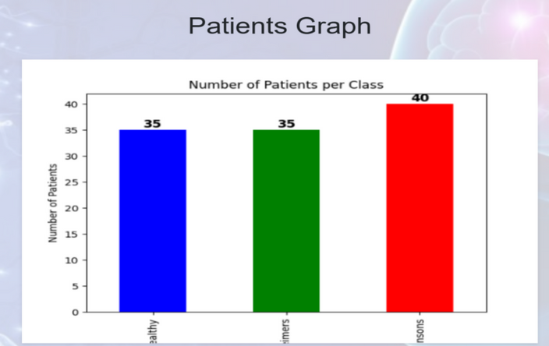
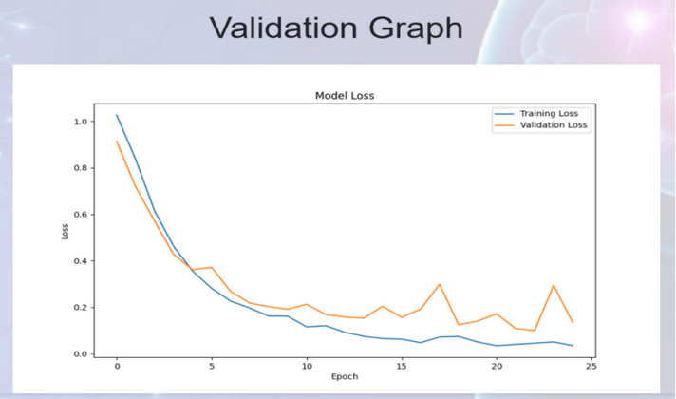
Graphical Representation:
Here we can see the Graphs which we considered to show the data in more efficient way.

Slide 20

Advancements & Future Scope:
Wearable and Mobile EEG Devices: Enables continuous monitoring of brain activity in real-world settings.
Personalized Medicine: Uses EEG signals to develop personalized treatment strategies based on individual brain activity profiles.

Slide 21
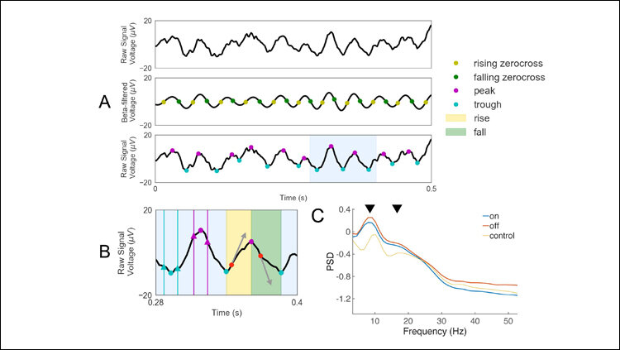
Conclusion:
In conclusion, the study of “Early detection and prediction of Parkinson's and Alzheimer's diseases using EEG signals” is a promising field in neuroscientific research and clinical practice, potentially impacting individuals at risk and promoting proactive brain health management.

Slide 22
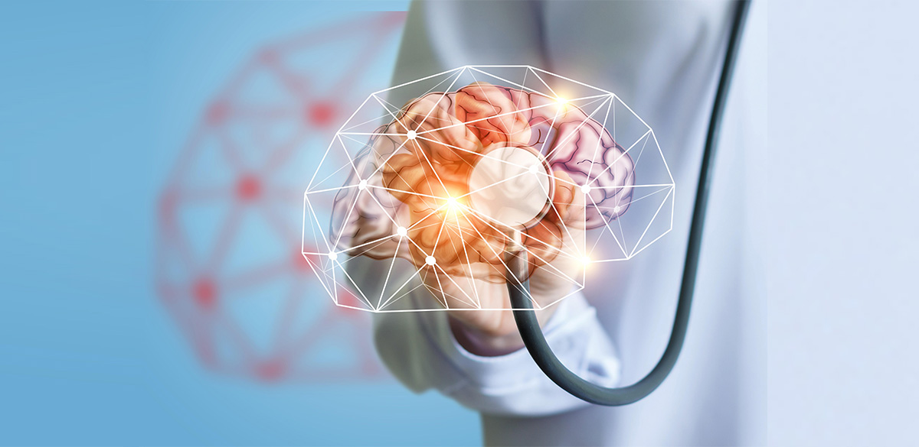
Thank you

